Slide 1

School of Mechanical Engineering
Course Code: Course Name: Engineering Design and Prototyping
Projection and Multi-View Drawing
Faculty Name: Dinesh Kumar Program Name: B.Tech First Year

Slide 2
Prerequisite/Recapitulations
Basics of Engineering Graphics
Drawing, Sketching

Slide 3
Objectives
To acquire knowledge about:
Introduction to Projection
Types of Projection
Orthographic Projection
Projection Symbols
Multi-View Drawings

Slide 4
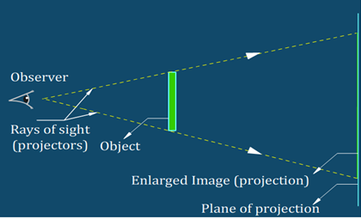
Introduction to Projection
Any kind of representation of an object on a paper, screen or similar surface by drawing or by photography is called the projection of that object.
Or, when ray of sights (projectors) are drawn from the eyes of the observer and are extended to fall on a plane of projection the object is said to be projected the image obtained is called projection. The size of image depends upon the position of the plane with respect to the object.
PROJECTORS: The imaginary line from block (object) to the plane is called projectors.
PLANE: The flat surface (such as a sheet of paper) is a plane.
PLANE OF PROJECTION: The plane which is used for the purpose of projection is called plane of projection.

Slide 5
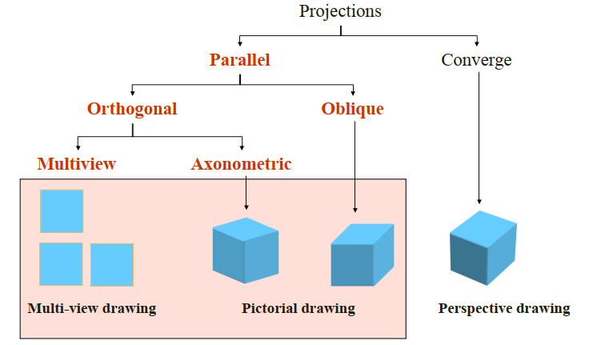
Types of Projection

Slide 6
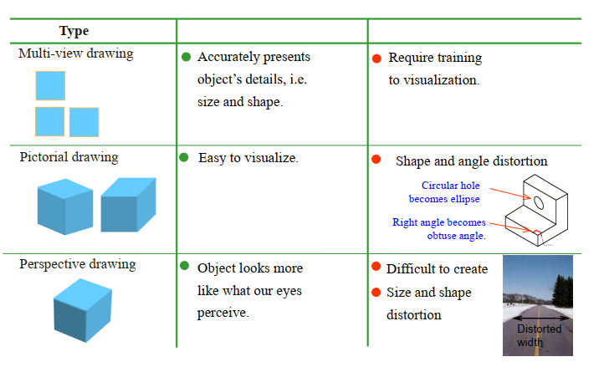
View comparison

Slide 7
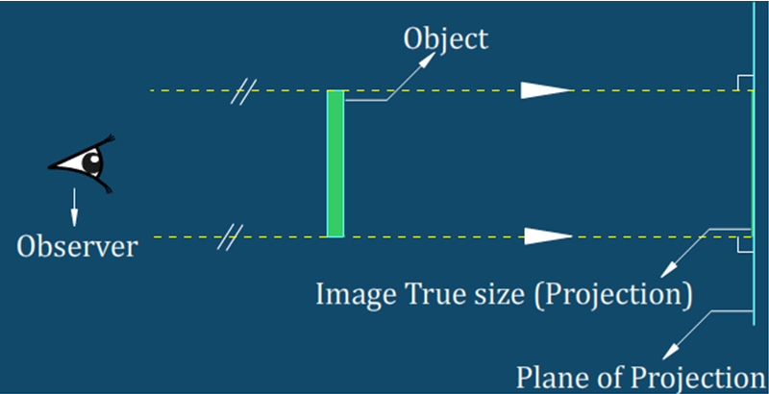
Orthographic Projection
When projectors are parallel to each other and perpendicular to the plane is called orthographic projection
Or, Ortho means perpendicular right angles graphics means right angle drawing
a technical drawing in which different views of an object are projected on different reference planes observing perpendicular to respective reference plane

Slide 8
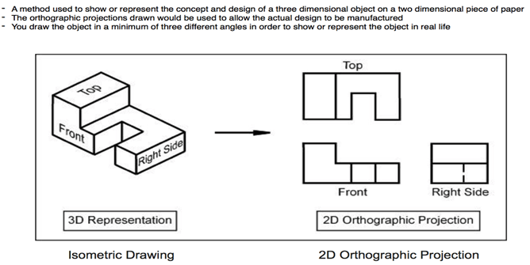
Orthographic Drawing

Slide 9
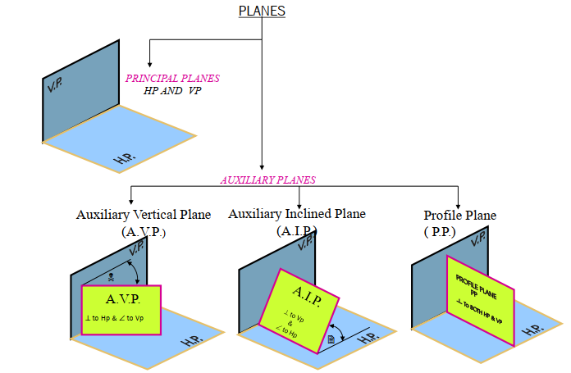
Reference Planes
Horizontal Plane (HP)
Vertical Plane (VP)
Side or Profile Plane (PP)

Slide 10
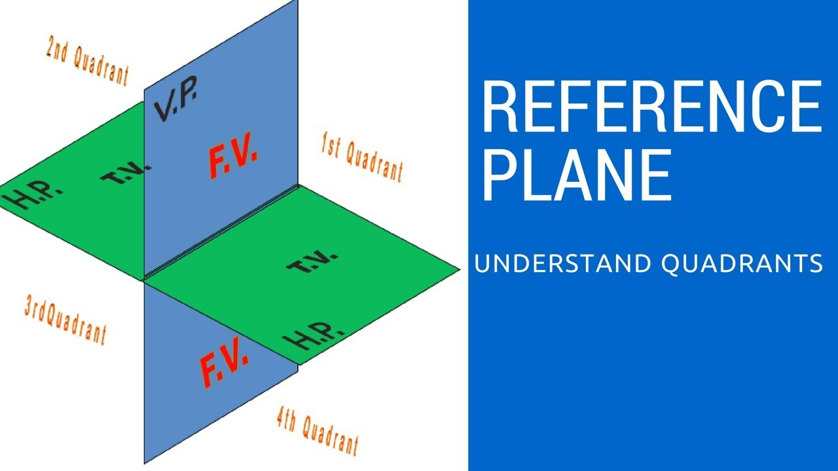
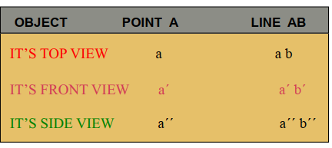
Different Views & Notations
– Front View (FV) – Projected on VP – Top View (TV) – Projected on HP – Side View (SV) – Projected on PP

Slide 11
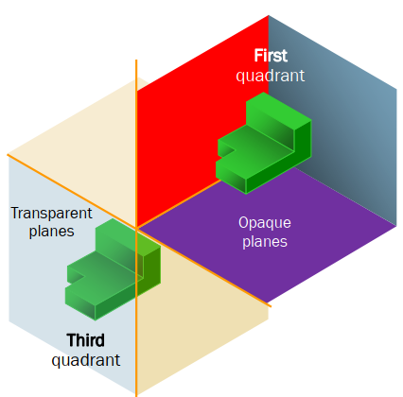
Projection systems
( SETUP:-OBSERVER----OBJECT----PLANE OF PROJECTION)
First angle system
- European countries - ISO standard
2. Third angle system - Canada, USA, Japan, Thailand
( SETUP:-OBSERVER----PLANE OF PROJECTION----OBJECT)

Slide 12
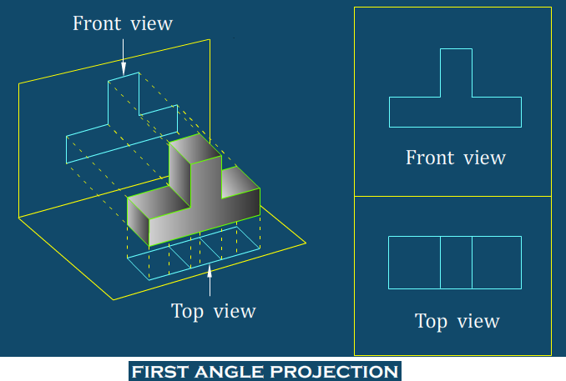
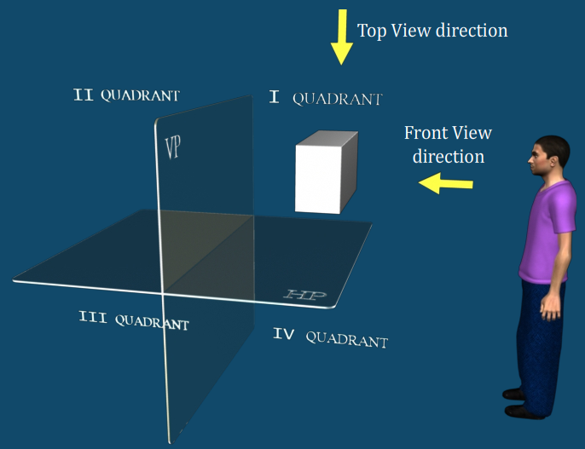
First Angle Projection
ROTATION OF PLANES:-
When the projection of an object has been made on the various planes they are brought together on a single sheet of paper by rotating the planes.
The standard practice of rotation of planes is to be keeping the VP fixed & to rotate the HP & PP in clock wise direction away from the object so that they may come in line with VP. The 1st & 3rd quadrant opened out while rotating the plane.
NOTE:-2ND & 4TH quadrant are not used since the FV & TV come(projected)on the same side of xy line & may overlap the view (FV & TV).so 2nd & 4th angles are not used In engineering drawing.

Slide 13
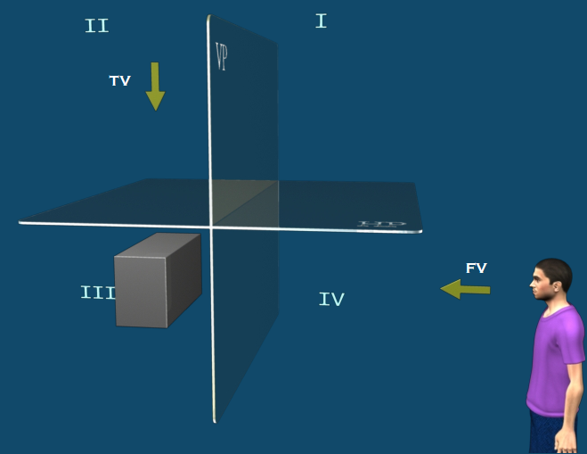
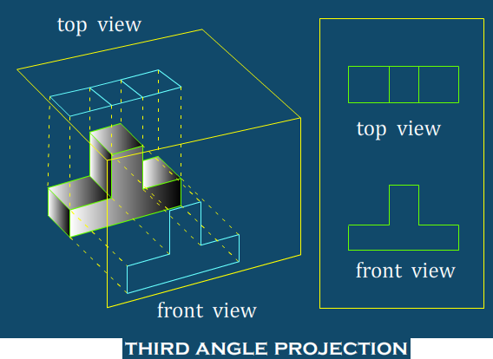
Third Angle Projection

Slide 14
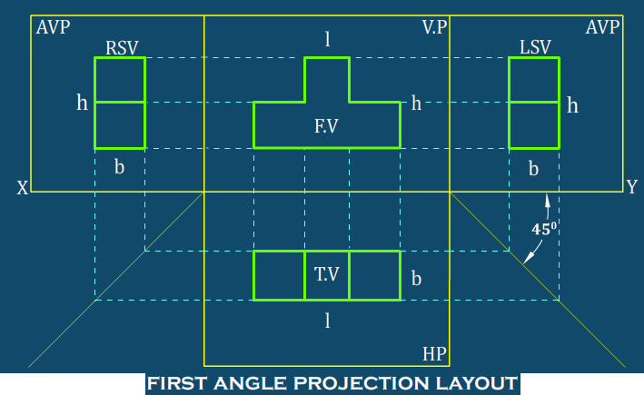
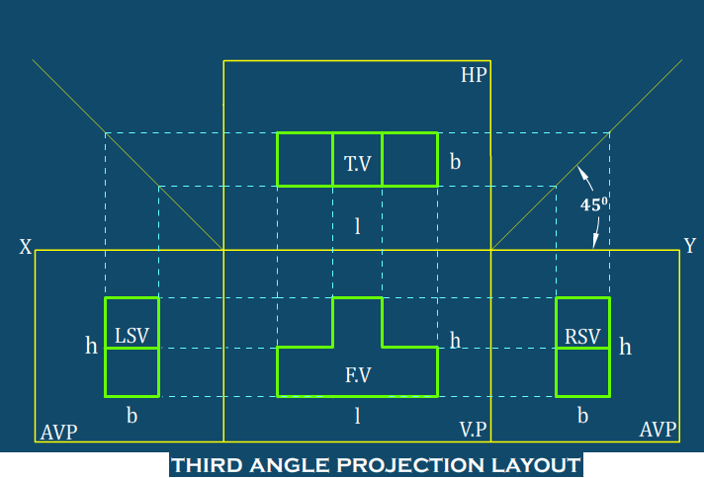
First Angle vs. Third Angle Projection
1ST ANGLE OF PROJECTION | 3RD ANGLE OF PROJECTION
The object is kept in the 1st quadrant. The object lies in between the observer & the Plane of projection The plane of projection is assumed to be Non-transparent In this method, when the views are drawn in their relative position, the plan comes below the FV/elevation or the TV drawn below the FV. The left side view is drawn to the right side of the FV. The right side view is drawn to the left side of the FV. This method of projection is used In European Countries & bureau of Indian standard is adopted w.e.f. 1981. | The object is assumed to keep in 3rd quadrant. The plane of projection lies between the observer and the object. The plane of projection is assumed to be transparent In this method, when the views are drawn in their relative position, the plan comes above the elevation or TV is drawn above the FV. The left side view is drawn to the left side of the FV. The right side view is drawn to the right side Of the FV. This method of projection is used In U.S.A & other countries

Slide 15
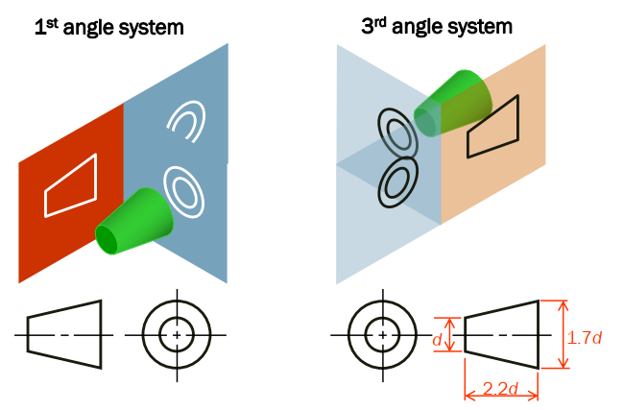
Projection Symbols
The front view & side view of a frustum of cone are used to show the symbol for projection method

Slide 16
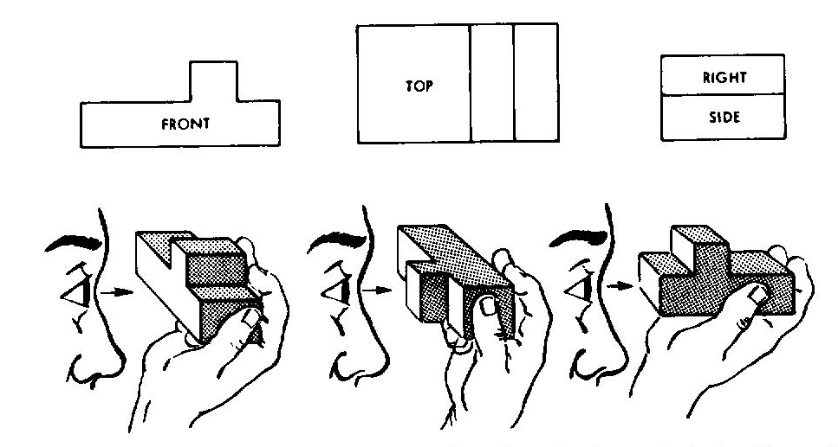
Viewing the object-Visualizing views
Notice how each view appears when looking directly at that view of the object.

Slide 17
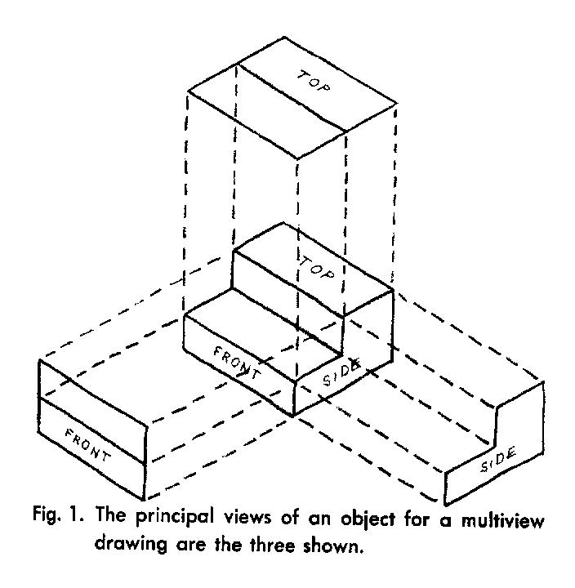
3 View Drawing Most Commonly Used Views
Front View
Top View
Side View
Color code can help to visualize

Slide 18
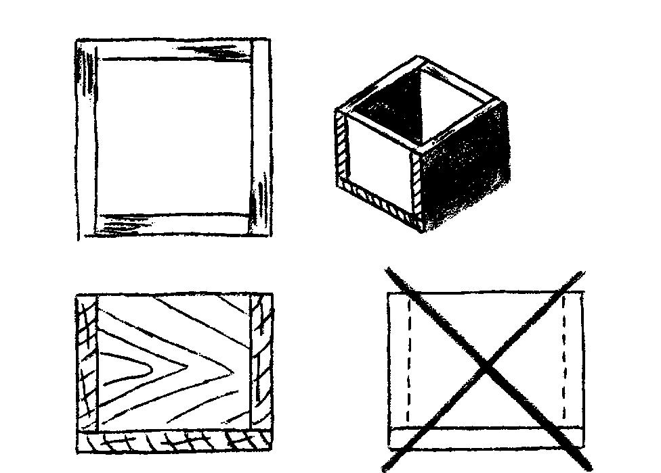
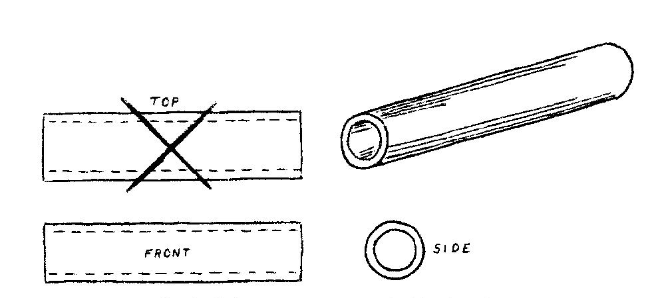
Duplicate Views are Unnecessary
Only 2 views are needed for these examples

Slide 19
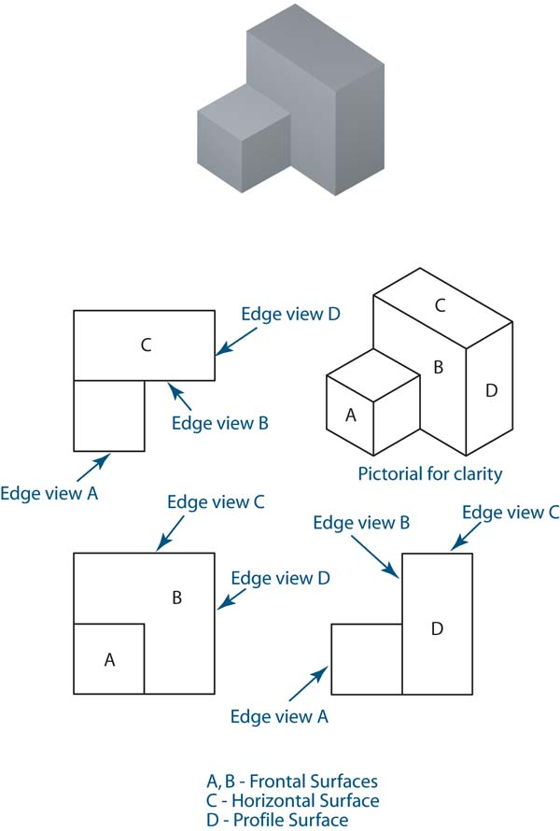
View Alignments
In orthographic projections, the views are aligned such that each point on the object is lined up with itself all three views.
Each view shows two dimensions
Top: width and depth
Front: height and width
Right side: height and depth
Width
Width
B
A
Depth
B
Depth
A
B
B
Height
A
A

Slide 20
View Alignments
In orthographic projections, the views are aligned such that each point on the object is lined up with itself all three views.
Each view shows two dimensions
Top: width and depth
Front: height and width
Right side: height and depth
Width
Width
B
A
Depth
B
Depth
A
B
B
Height
A
A

Slide 21
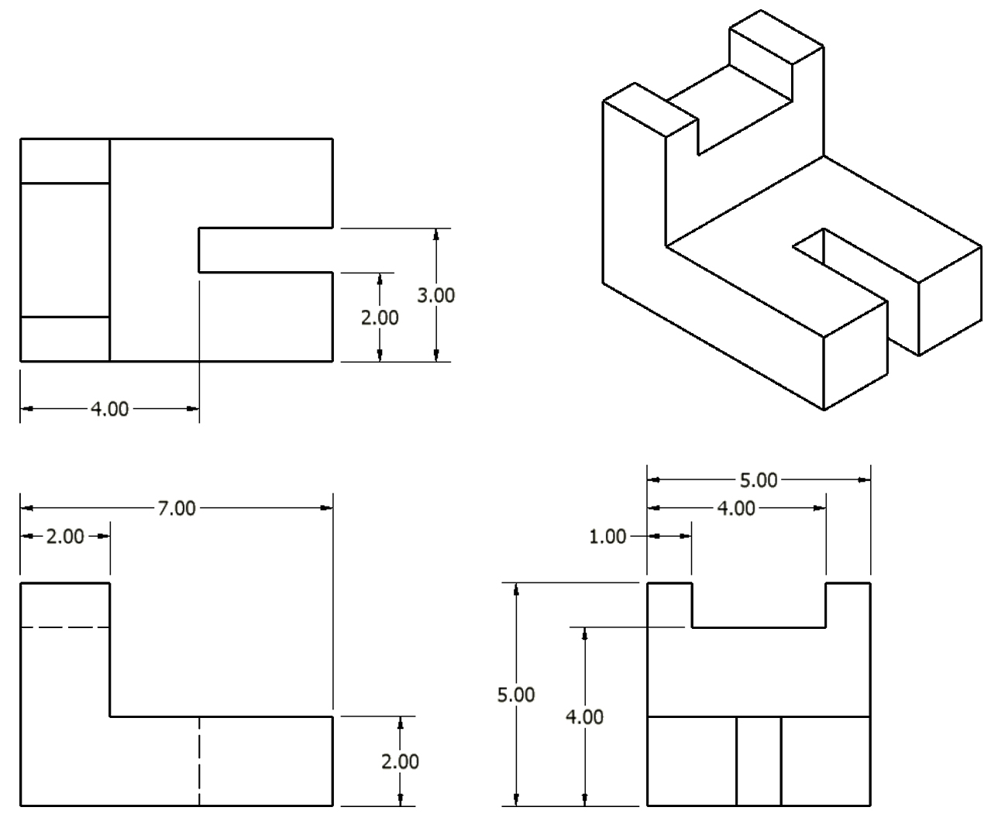
Multi-View Drawings
A multiview drawing is one that shows two or more two-dimensional views of a three-dimensional object.
Multiview drawings provide the shape description of an object. When combined with dimensions, multiview drawings serve as the main form of communication between designers and manufacturers

Slide 22
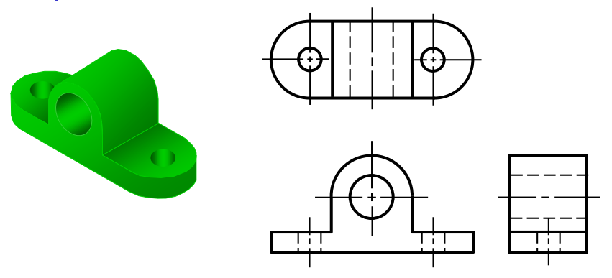
Multi-View Drawings

Slide 23
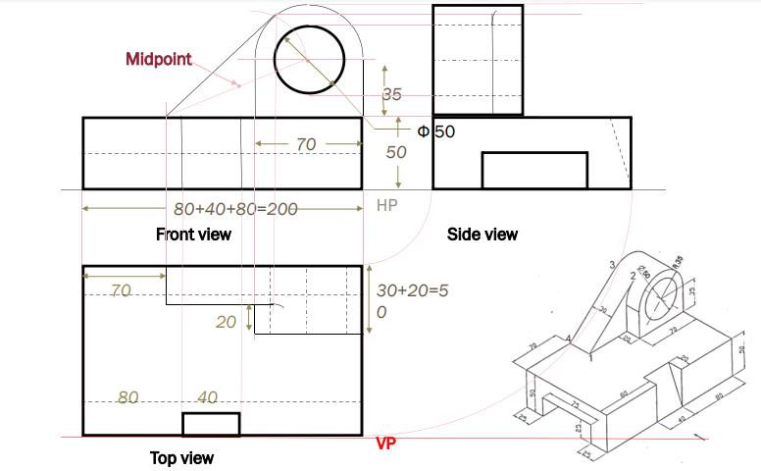
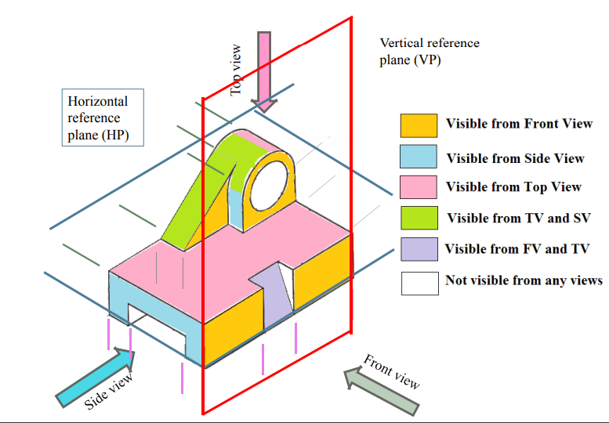
Summary

Slide 24
Summary
A projection is defined as representation of an object on a two dimensional plane. The following are the elements to be considered while obtaining a projection.
The object
The plane of projection
The point of sight and
The ray of sight
When drawing the orthographic projection the following items should be invariable exist.
The object to be projected.
The projectors
The plane of projection
The observer’s eye or station point
2ND & 4TH quadrant are not used since the FV & TV come(projected)on the same side of xy line & may overlap the view (FV & TV).so 2nd & 4th angles are not used In engineering drawing

Slide 25
Questions
How do you explain Orthographic Projection?
Why second and fourth angle projections are not used?
Differentiate first and third angle projection on the basis of placement of different views with respect to reference plane?
Why do we use multi-views in engineering design?

Slide 26
References
Engineering Drawing by N. D. Bhatt and V. M. Panchal
Engineering Graphics by K. C. John
NPTEL

Slide 27
Thank You

